Slide 1
Correspondence Analysis

Slide 2
Examples – Contingency Table
Cross-classification of mental health status and parental socioeconomic status from midtown Manhattan
Mental health category | A | B | C | D | E | F
Well | 64 | 57 | 57 | 72 | 36 | 21
Mild symptom formation | 94 | 94 | 105 | 141 | 97 | 71
Moderate symptom formation | 58 | 54 | 65 | 77 | 54 | 54
Impaired | 46 | 40 | 60 | 94 | 78 | 71
Cross-classification of mental health status and parental socioeconomic status from midtown Manhattan

Slide 3
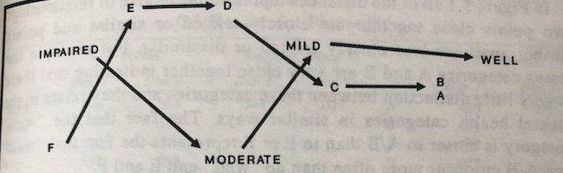
Plot for optimal scores
Distance represent the degree of relationship: 2 points are close together are closely related or similar. Points further apart are less closely related or dissimilar.
A and B are close
C and D are fairly close

Slide 4
Condense the data
Mental health category | A +B | C +D | E | F | Total
Well | 121 | 129 | 36 | 21 | 307
Mild + Moderate | 300 | 388 | 151 | 125 | 964
Impaired | 86 | 154 | 78 | 71 | 389
Total | 507 | 671 | 265 | 217 | 1660

Slide 5
Questions
(1) Is the apparent relationship statistically significant?
(2) Is the apparent relationship continuous, that is, more or less equal among status group?
(3) Are the categories ordered and fairly equally spaced?
(4) Are some pairs of categories so similar that they should be combined?
Chi-square test can answer the question (1)
CA can handle the rest of 3 questions

Slide 6
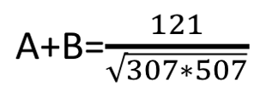
Mechanics of CA
Step 1 - Correspondence analysis begins with a normalization of the data that divides each row entry by the square root of the product of corresponding row and column totals.
Mental health category | A +B | C +D | E | F | Total
Well | 121 | 129 | 36 | 21 | 307
Mild + Moderate | 300 | 388 | 151 | 125 | 964
Impaired | 86 | 154 | 78 | 71 | 389
Total | 507 | 671 | 265 | 217 | 1660
Mental health category | A +B | C +D | E | F
Well | .30670 | .28422 | .12621 | .08136
Mild + Moderate | .42912 | .48243 | .29876 | .27330
Impaired | .19365 | .30143 | .24294 | .24437

Slide 7
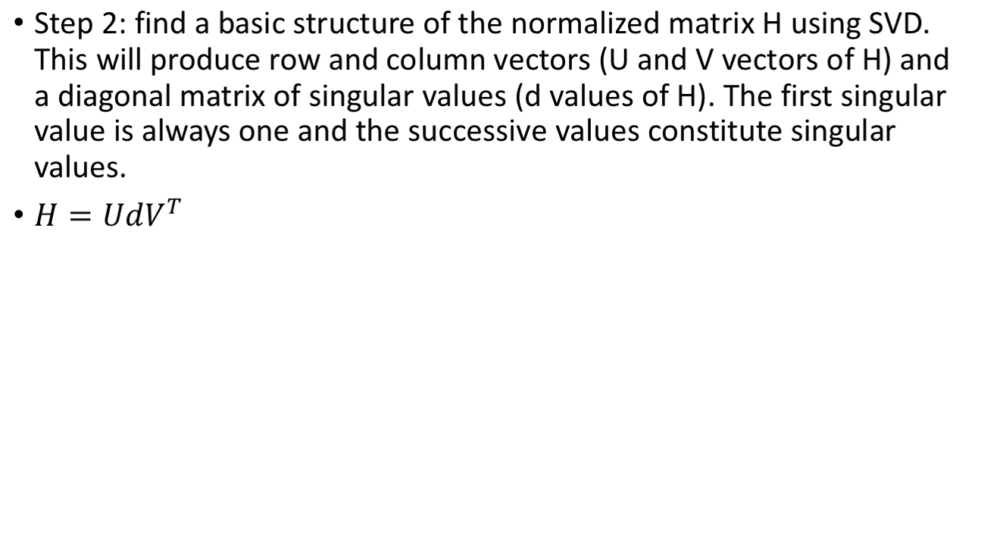
Mechanics of CA
Row vector U | Dim 0 | Dim 1 | Dim 2
Well | .430 | .702 | -0.568
Mild + Moderate | .762 | .055 | .645
Impaired | .484 | -.710 | -.511
Singular values | 1.00 | .159 | .008
Column vector V | Dim 0 | Dim 1 | Dim 2
A + B | .533 | .638 | .455
C + D | .636 | .075 | -.512
E | .399 | -.425 | -.373
F | .362 | -.638 | .633
Singular values | 1.00 | .159 | .008

Slide 8
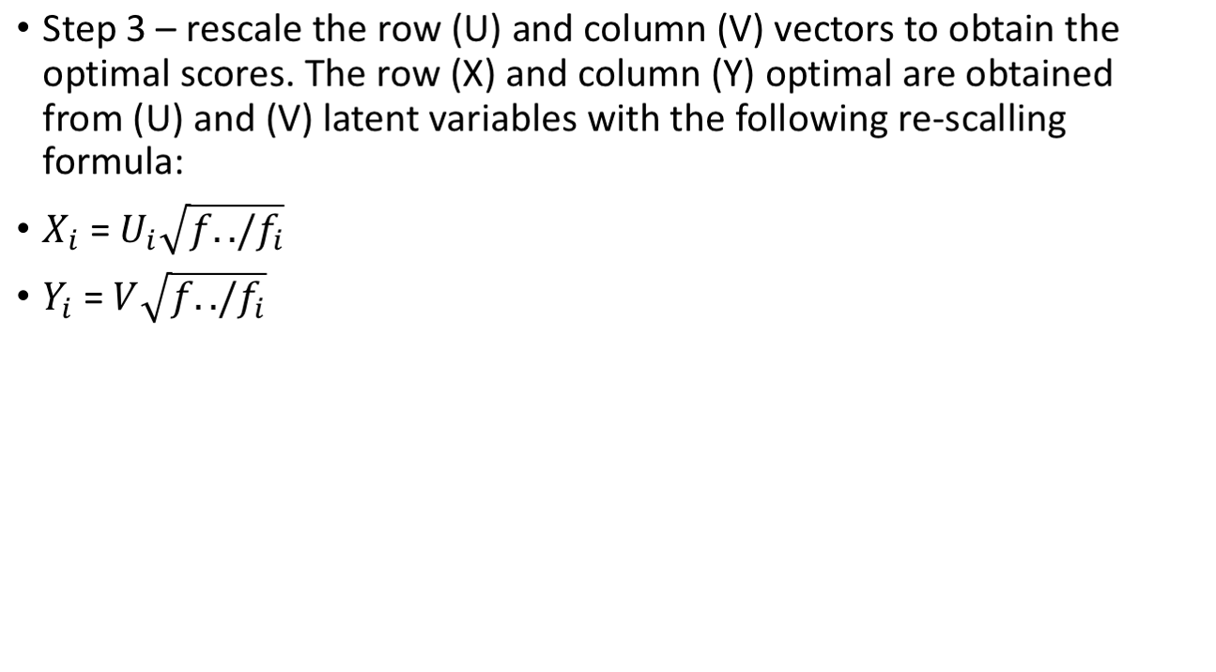
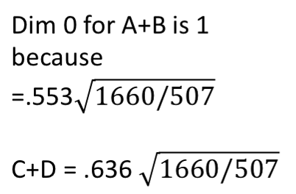
Mechanics of CA
 | Row Optimal Scores (X)
 | Dim 0 | Dim 1 | Dim 2
Well | 1 | 1.632 | -1.321
Mild + Moderate | 1 | .073 | .847
Impaired | 1 | -1.467 | -1.056
 | Column Optimal Scores (Y)
 | Dim 0 | Dim 1 | Dim 2
A+B | 1 | 1.154 | 0.805
C + D | 1 | .119 | -.805
E | 1 | -1.063 | -.935
F | 1 | -1.765 | 1.75
This step is to standardize coordinates rows and columns

Slide 9
Mechanics of CA
Step 4 - to create principal coordinates for rows and columns. This is to interpret the relationship between rows; and between columns. Calculating the principal coordinates is as simple as taking the standard coordinates, and multiplying them by their corresponding singular values(d)
Step 5 – Principal inertias

Slide 10
CA package in R
factoMineR package for analysis
factoextra for data visualization
ade4 package
Visualization package: factoextra, ggplot2

Slide 11
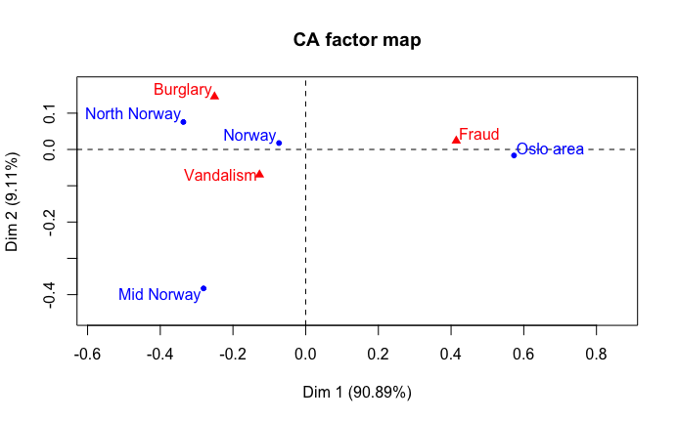
Crime - Output from Correspondence Analysis
We see that the point that represents the whole country lies in the direction of mid Norway and north Norway. This means that these two parts of the country have profiles relatively similar to the profile for the country as a whole, whereas Oslo is more atypical

Slide 12
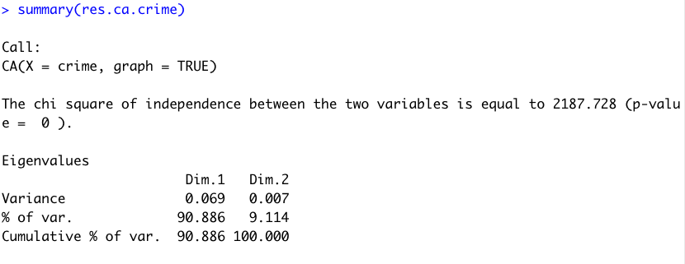
Crime - Output from Correspondence Analysis
Eigenvalues:
- Try to represent the relationship between variables in as few dimensions as possible
- Here we see that the first-dimension capture 90.9% of the variance
- Both dimensions capture all the variance

Slide 13
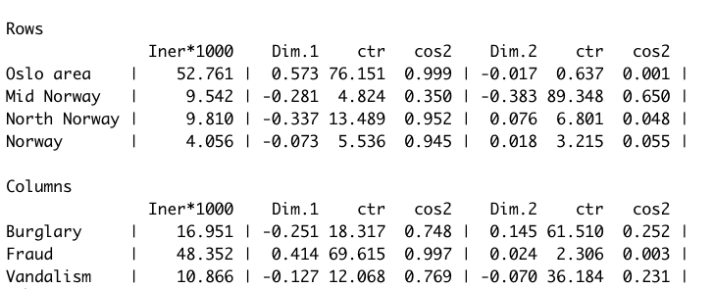
Crime - Output from Correspondence Analysis
Dim 1&2:
- The coordinate of rows on first and second dimensions
- Oslo area has the coordinate (0.573, -0.017)
- Fraud has the coordinate (0.414, 0.024)

Slide 14
Crime - Output from Correspondence Analysis
ctr: contribution
- How much each row column contribute to a dimension
- Oslo area contributes to 76,1 to dimension 1
- Fraud contributes to 69.6 to dimension 1

Slide 15
Crime - Output from Correspondence Analysis
cos2: Squared cosine (cos2) is a measure of the quality of representation
- or how well each row and column item is represented by the retained number of dimensions
- Fraud represents well in dimension 1 but not dimension 2

Slide 16
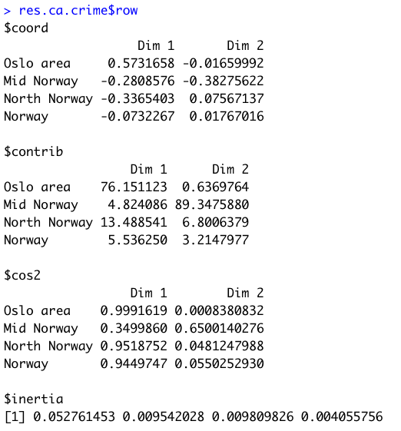
Crime - Output from Correspondence Analysis
Inertia: decomposing the overall Chi-square statistic (or Inertia=Chi-square/Total N) by identifying a small number of dimensions in which the deviations from the expected values can be represented. This is similar to the goal of Factor Analysis, where the total variance is decomposed, so as to arrive at a lower-dimensional representation of the variables that allows one to reconstruct most of the variance/covariance matrix of variables.
Notes:
Inertia = in applied mathematics of "moment of inertia," which stands for the integral of mass times the squared distance to the centroid.

Slide 17
Applications
It is possible to represent on the same graph consumer preferences for different brands and characteristics of a specific product (e.g. car brands together with colour, power, size, etc.)
This allows one to explore brand choice in relation to characteristics opening the way to product modifications and innovations to meet consumer preferences
Correspondence analysis is particularly useful when the variables have many categories
The application to metric (continuous) data is not ruled out but data need to be categorized first

Slide 18
Summary
Correspondence analysis is a compositional technique which starts from a set of product attributes to portrait the overall preference for a brand
This technique is very similar to PCA and can be employed for data reduction purposes or to plot perceptual maps
Because of the way it is constructed correspondence analysis can be applied to either the row or the columns of the data matrix
For example if rows represent brands and columns are different attributes:
  By applying the method by rows one obtains the coordinates for the brands
  The application by columns allows one to represent the attributes in the same graph

Slide 19
Steps to run correspondence analysis
Represent the data in a contingency table
Translate the frequencies of the contingency table into a matrix of metric (continuous) distances through a set of Chi-square association measures on the row and column profiles
Extract the dimensions (in a similar fashion to PCA)
Evaluate the explanatory power of the selected number of dimensions
Plot row and column objects in the same co-ordinate space

Slide 20
Representations
Take the row profile (the categories of x) and plot the categories in a bi-dimensional graph, using the categories of y to define the distances
This allows one to compare nominal categories within the same variable: those categories of x which show similar levels of association with a given category of y can be considered as closer than those with very different levels of association with the same category of y
The same procedure is carried out transposing the table which means that the categories of y can be represented using the categories of x to define the distances

Slide 21
Inertia
Inertia is a measure of association between two categorical variables based on the Chi-squared statistic.
In correspondence analysis the proportion of inertia explained by each of the dimensions can be regarded as a measure of goodness-of-fit because the effectiveness of correspondence analysis depends on the degree of association between x and y
Total inertia
  is a measure of the overall association between x and y
  is equal to the sum of the eigenvalues
  corresponds to the Chi-square value divided by the number of observations
  A total inertia above 0.20 is expected for adequate representations
Inertia values can be computed for each of the dimensions and represent the contribution of that dimension to the association (Chi-square) between the two variables

Slide 22
Number of dimensions
The maximum number of dimensions for the analysis is equal to
  the number of rows minus one, or
  the number of columns minus one (whichever the smaller)
In our example, the maximum number of dimensions would be five which reduces to four due to missing values in one row category.
As shown later in this section one may then choose to graphically represent only a sub-set of the extracted dimensions (usually two or three) to make interpretation easier

Slide 23
Distance measure
Chi-square distance
Euclidean distance
  uses the square root of the sum of squared differences between pairs of rows and pairs of columns
  this also requires one to choose a method for centering the data

